Slide 1
Development and Adoption of the 7th Edition (2020) Florida Building Code
Commission Meeting February 2018
Building Codes and Standards
Department of Business and Professional Regulation

Slide 2
553.73 Florida Building Code – Florida Statutes
(7)(a) The commission shall adopt an updated Florida Building Code every 3 years through review of the most current updates of the International Building Code, the International Fuel Gas Code, International Existing Building Code, the International Mechanical Code, the International Plumbing Code, and the International Residential Code, all of which are copyrighted and published by the International Code Council, and the National Electrical Code, which is copyrighted and published by the National Fire Protection Association….

Slide 3
Two Step Process
Step 1 - Review of the 2018 updates to the International Building Codes (I-Codes)
Step 2 – Triennial Code Change Process

Slide 4
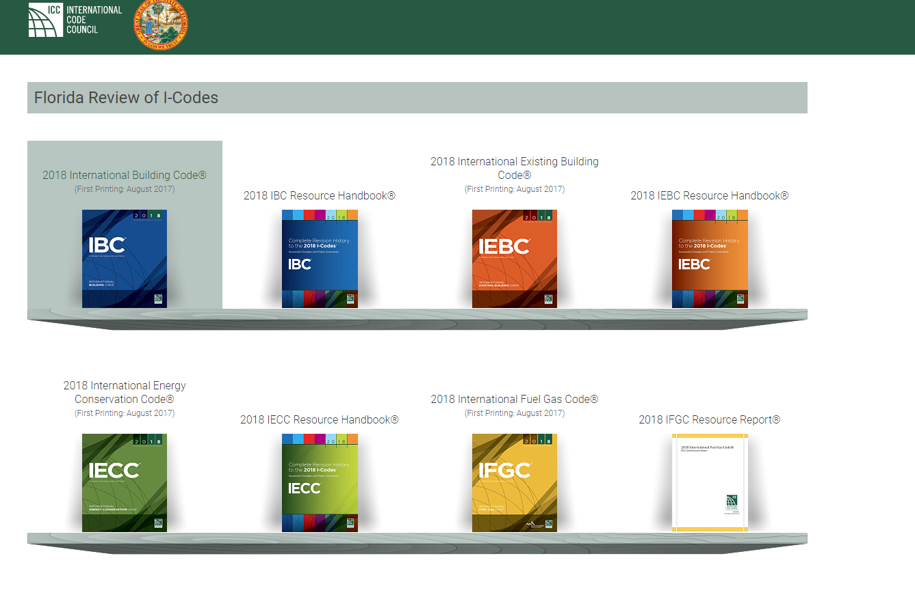
Step 1- Review of the 2018 updates to the International Building Codes (I-Codes)
Complete listing of the Code changes to the Updated I-Codes – Posted as of 1/2/2018
Link to the 2018 I-Codes
Link to the 2018 IBC Resource Handbook
Link to the 2017 National Electrical Code (NEC) and the 2017 NEC Changes

Slide 5
2018 Modifications to the I-Codes:
Total number of modifications: 1271
Number of modifications by TAC:
Fire TAC – | 314
Structural TAC – | 342
Roofing TAC – | 41
Energy TAC – | 170
Mechanical TAC – | 109
Plumbing TAC – | 181
Special Occupancy TAC – | 16
Electrical TAC /Swimming Pool TAC- | 98 (majority of the changes are IRC electrical provisions)
Code Admin TAC- | 38

Slide 6
2018 Modifications to the International Residential Code (IRC)
Building (Fire, Structural, Flood, Roofing) | 140
Mechanical | 27
Plumbing | 9
Energy | 46
Electrical | 94
 | Total 316

Slide 7
Proposed Scope of Work –
Develop tracking charts and detail reports:
Approach: Staff will develop tracking charts for use by the TACs to review the I-Code changes.
The tracking charts will provide for the following:
Code change number
Code section
Change summary between the 2015 I-Codes and the 2018 I-Codes including statement of “Cost impact”
Change summary between the 2017 FBC and 2018 I-Codes
Staff comment including whether the I-Code change overlapping an existing Florida specific change
Hyperlink modification number to the code change monographs

Slide 8
Fire correlation between the FFPC and FBC (Florida Law)
Continue to use the definition for “conflict” as the basis for correlation with the FFPC.
  Conflict means a construction specification such as a dimension in one code that would prevent compliance with the other code
National Electrical Code – 2017
  Treat as reference standard update:
    FFPC- consistence with the future update to the FFPC which treats the NEC as a reference standard
    FBC- Consistence with the FBC treatment of the NEC as a reference standard (see section 2701 and Chapter 35 of the FBC, Building)
      Note: The 2017 Changes to the NEC are available for review from the link above.

Slide 9
Step 2 – Triennial Code Change Process
  Codes/Provisions Subject to this process:
    The 2017 Florida Building Code
    2018 Changes to the I-Code
    Overlapping provisions (I-Code Changes overlapping an existing Florida specific change)
    Changes to the NEC
    Others as deemed necessary

